Slide 1
Underfitting vs. Overfitting and Underfitting in ML

Slide 2
Even when we’re working on a machine learning project, we often face situations where we are encountering unexpected performance or error rate differences between the training set and the test set (as shown below). How can a model perform so well over the training set and just as poorly on the test set?

Slide 3
Generalization in Machine Learning
In machine learning we describe the learning of the target function from training data as inductive learning.
Induction refers to learning general concepts from specific examples which is exactly the problem that supervised machine learning problems aim to solve. This is different from deduction that is the other way around and seeks to learn specific concepts from general rules.
Generalization refers to how well the concepts learned by a machine learning model apply to specific examples not seen by the model when it was learning.
The goal of a good machine learning model is to generalize well from the training data to any data from the problem domain. This allows us to make predictions in the future on data the model has never seen.
There is a terminology used in machine learning when we talk about how well a machine learning model learns and generalizes to new data, namely overfitting and underfitting.
Overfitting and underfitting are the two biggest causes for poor performance of machine learning algorithms.

Slide 4
Statistical Fit
In statistics, a fit refers to how well you approximate a target function.
This is good terminology to use in machine learning, because supervised machine learning algorithms seek to approximate the unknown underlying mapping function for the output variables given the input variables.
Statistics often describe the goodness of fit which refers to measures used to estimate how well the approximation of the function matches the target function.
Some of these methods are useful in machine learning (e.g. calculating the residual errors), but some of these techniques assume we know the form of the target function we are approximating, which is not the case in machine learning.
If we knew the form of the target function, we would use it directly to make predictions, rather than trying to learn an approximation from samples of noisy training data.

Slide 5
Overfitting in Machine Learning
Overfitting refers to a model that models the training data too well.
Overfitting happens when a model learns the detail and noise in the training data to the extent that it negatively impacts the performance of the model on new data. This means that the noise or random fluctuations in the training data is picked up and learned as concepts by the model. The problem is that these concepts do not apply to new data and negatively impact the models ability to generalize.
Overfitting is more likely with nonparametric and nonlinear models that have more flexibility when learning a target function. As such, many nonparametric machine learning algorithms also include parameters or techniques to limit and constrain how much detail the model learns.
For example, decision trees are a nonparametric machine learning algorithm that is very flexible and is subject to overfitting training data. This problem can be addressed by pruning a tree after it has learned in order to remove some of the detail it has picked up.

Slide 6
Underfitting in Machine Learning
Underfitting refers to a model that can neither model the training data nor generalize to new data.
An underfit machine learning model is not a suitable model and will be obvious as it will have poor performance on the training data.
Underfitting is often not discussed as it is easy to detect given a good performance metric. The remedy is to move on and try alternate machine learning algorithms. Nevertheless, it does provide a good contrast to the problem of overfitting.

Slide 7
A Good Fit in Machine Learning
Ideally, you want to select a model at the sweet spot between underfitting and overfitting.
This is the goal, but is very difficult to do in practice.
To understand this goal, we can look at the performance of a machine learning algorithm over time as it is learning a training data. We can plot both the skill on the training data and the skill on a test dataset we have held back from the training process.
Over time, as the algorithm learns, the error for the model on the training data goes down and so does the error on the test dataset. If we train for too long, the performance on the training dataset may continue to decrease because the model is overfitting and learning the irrelevant detail and noise in the training dataset. At the same time the error for the test set starts to rise again as the model’s ability to generalize decreases.
The sweet spot is the point just before the error on the test dataset starts to increase where the model has good skill on both the training dataset and the unseen test dataset.
You can perform this experiment with your favorite machine learning algorithms. This is often not useful technique in practice, because by choosing the stopping point for training using the skill on the test dataset it means that the testset is no longer “unseen” or a standalone objective measure. Some knowledge (a lot of useful knowledge) about that data has leaked into the training procedure.
There are two additional techniques you can use to help find the sweet spot in practice: resampling methods and a validation dataset.

Slide 8
How To Limit Overfitting
Both overfitting and underfitting can lead to poor model performance. But by far the most common problem in applied machine learning is overfitting.
Overfitting is such a problem because the evaluation of machine learning algorithms on training data is different from the evaluation we actually care the most about, namely how well the algorithm performs on unseen data.
There are two important techniques that you can use when evaluating machine learning algorithms to limit overfitting:
Use a resampling technique to estimate model accuracy.
Hold back a validation dataset.

Slide 9
The most popular resampling technique is k-fold cross validation. It allows you to train and test your model k-times on different subsets of training data and build up an estimate of the performance of a machine learning model on unseen data.
A validation dataset is simply a subset of your training data that you hold back from your machine learning algorithms until the very end of your project. After you have selected and tuned your machine learning algorithms on your training dataset you can evaluate the learned models on the validation dataset to get a final objective idea of how the models might perform on unseen data.
Using cross validation is a gold standard in applied machine learning for estimating model accuracy on unseen data. If you have the data, using a validation dataset is also an excellent practice.

Slide 10
Precision can be seen as a measure of quality, and
recall as a measure of quantity. Higher precision means that an algorithm returns more relevant results than irrelevant ones, and high recall means that an algorithm returns most of the relevant results (whether or not irrelevant ones are also returned).
Recall (Sensitivity) - Recall is the ratio of correctly predicted positive observations to the all observations in actual class - yes. ...
F1 score - F1 Score is the weighted average of Precision and Recall. Therefore, this score takes both false positives and false negatives into account.

Slide 11
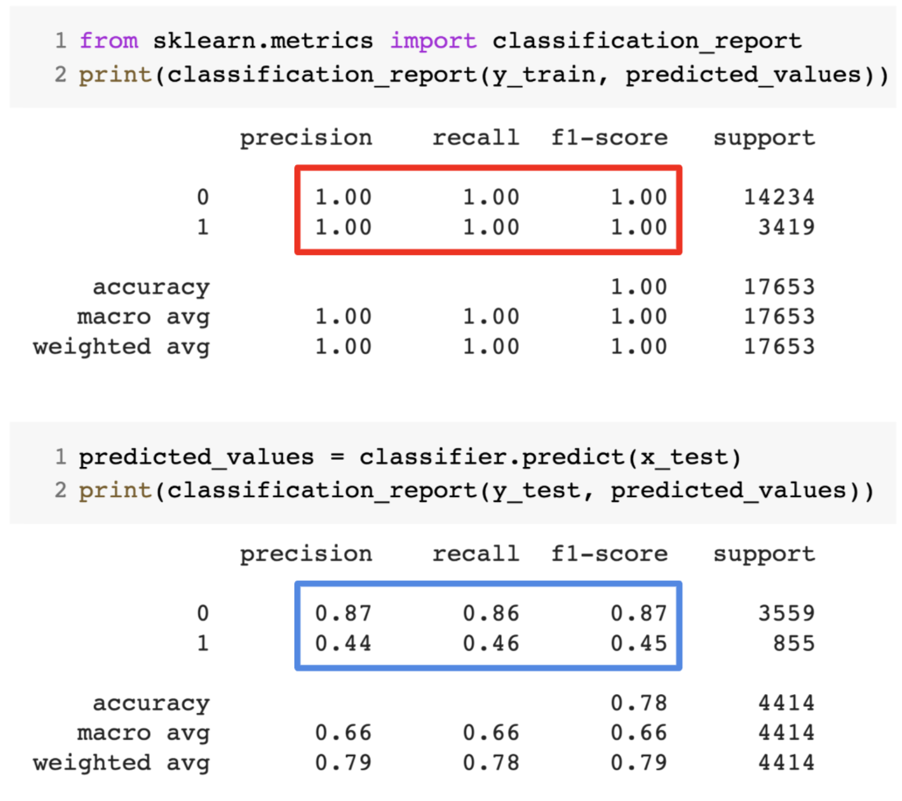

Slide 12
This happens very frequently whenever I am working with tree-based predictive models. Because of the way the algorithms work, you can imagine how tricky it is to avoid falling into the overfitting trap!
Moreover, it can be quite daunting when we are unable to find the underlying reason why our predictive model is exhibiting this anomalous behavior.
Here’s my personal experience – ask any seasoned data scientist about this, they typically start talking about some array of fancy terms like Overfitting, Underfitting, Bias, and Variance. But little does anyone talk about the intuition behind these machine learning concepts. Let’s rectify that, shall we?

Slide 13
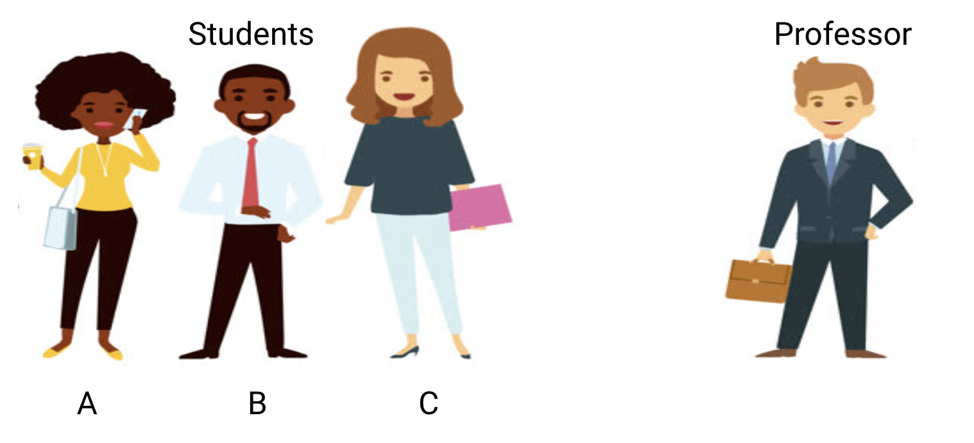
Let’s Take an Example to Understand Underfitting vs. Overfitting
I want to explain these concepts using a real-world example. A lot of folks talk about the theoretical angle but I feel that’s not enough – we need to visualize how underfitting and overfitting actually work.

Slide 14
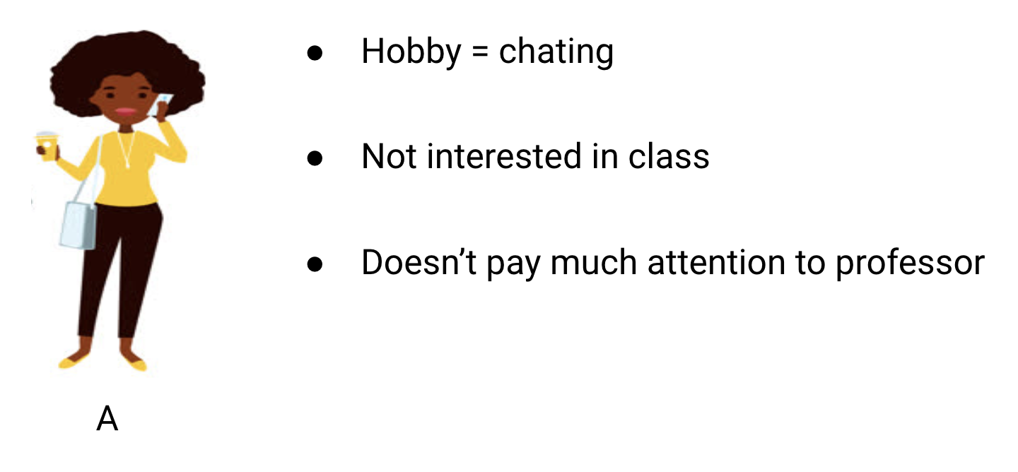
Consider a math class consisting of 3 students and a professor.
Now, in any classroom, we can broadly divide the students into 3 categories. We’ll talk about them one-by-one.
Let’s say that student A resembles a student who does not like math. She is not interested in what is being taught in the class and therefore does not pay much attention to the professor and the content he is teaching.

Slide 15
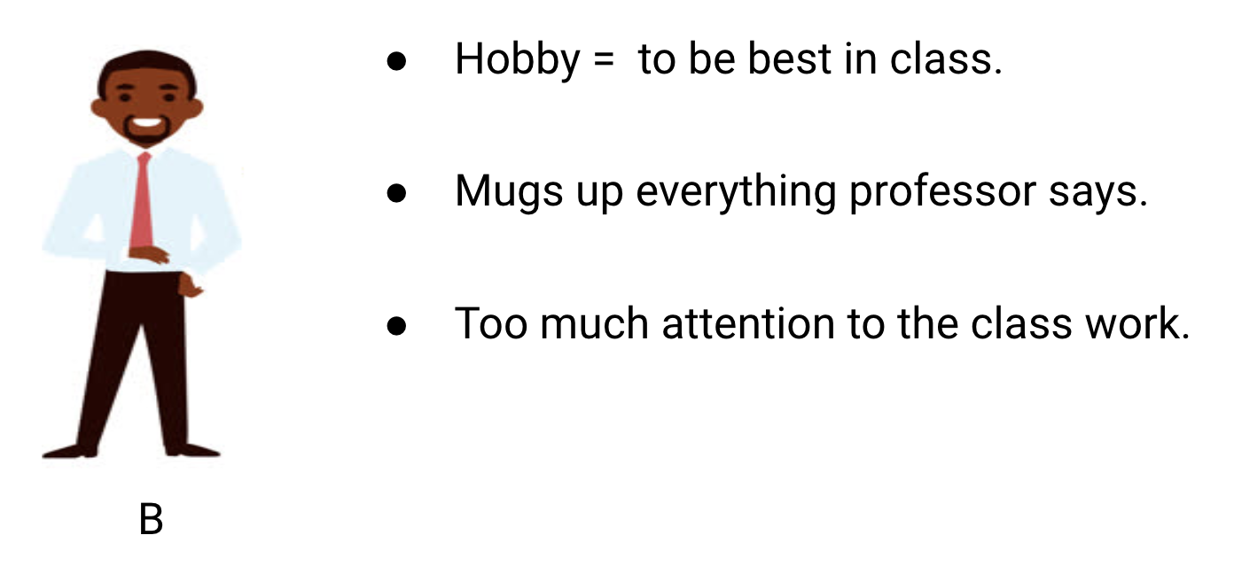
Let’s consider student B. He is the most competitive student who focuses on memorizing each and every question being taught in class instead of focusing on the key concepts. Basically, he isn’t interested in learning the problem-solving approach.

Slide 16
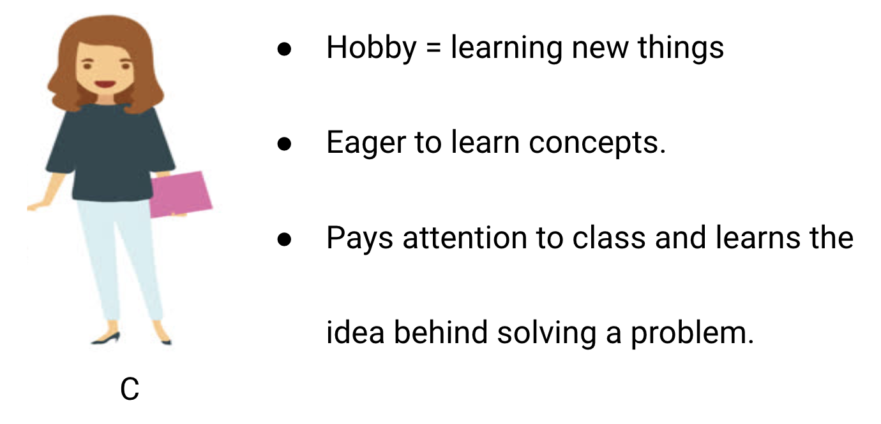
Finally, we have the ideal student C. She is purely interested in learning the key concepts and the problem-solving approach in the math class rather than just memorizing the solutions presented.

Slide 17
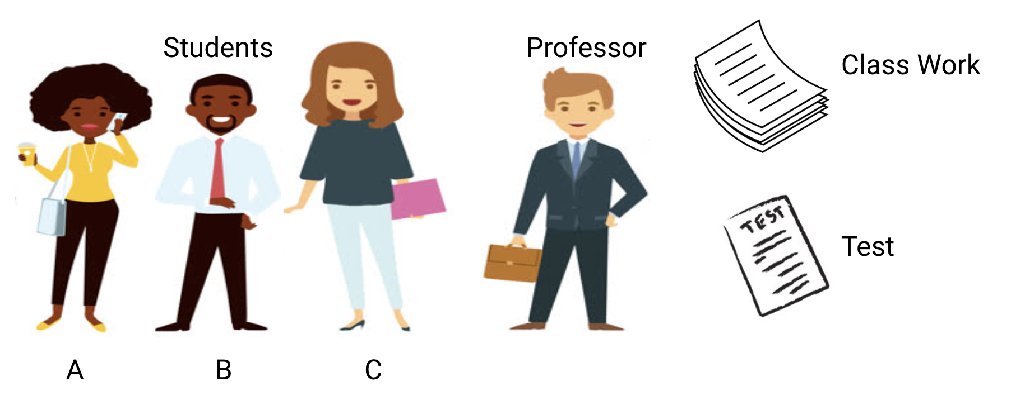

Slide 18
We all know from experience what happens in a classroom. The professor first delivers lectures and teaches the students about the problems and how to solve them. At the end of the day, the professor simply takes a quiz based on what he taught in the class.
The obstacle comes in the semester3 tests that the school lays down. This is where new questions (unseen data) comes up. The students haven’t seen these questions before and certainly haven’t solved them in the classroom. Sounds familiar?

Slide 19
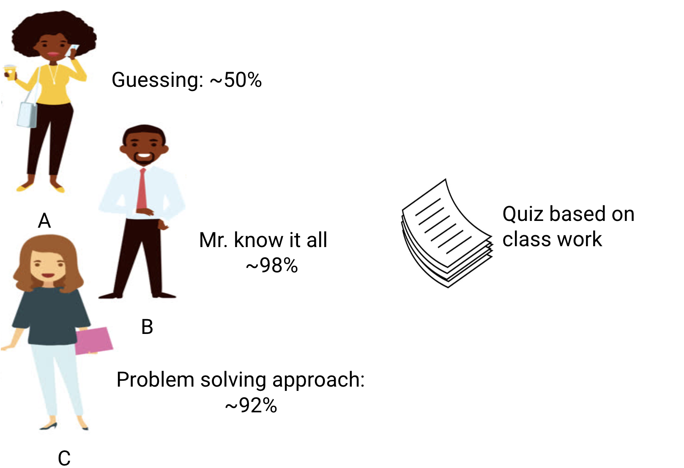
So, let’s discuss what happens when the teacher takes a classroom test at the end of the day:

Slide 20
Student A, who was distracted in his own world, simply guessed the answers and got approximately 50% marks in the test
On the other hand, the student who memorized each and every question taught in the classroom was able to answer almost every question by memory and therefore obtained 98% marks in the class test
For student C, she actually solved all the questions using the problem-solving approach she learned in the classroom and scored 92%

Slide 21
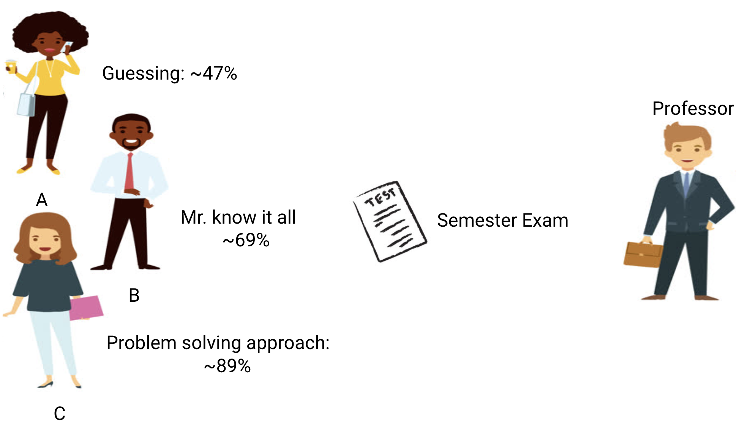
We can clearly infer that the student who simply memorizes everything is scoring better without much difficulty.
Now here’s the twist. Let’s also look at what happens during the monthly test, when students have to face new unknown questions which are not taught in the class by the teacher.

Slide 22
In the case of student A, things did not change much and he still randomly answers questions correctly ~50% of the time.
In the case of Student B, his score dropped significantly. Can you guess why? This is because he always memorized the problems that were taught in the class but this monthly test contained questions which he has never seen before. Therefore, his performance went down significantly
In the case of Student C, the score remained more or less the same. This is because she focused on learning the problem-solving approach and therefore was able to apply the concepts she learned to solve the unknown questions

Slide 23
How Does this Relate to Underfitting and Overfitting in Machine Learning?
You might be wondering how this example relates to the problem which we encountered during the train and test scores of the decision tree classifier? Good question!

Slide 24
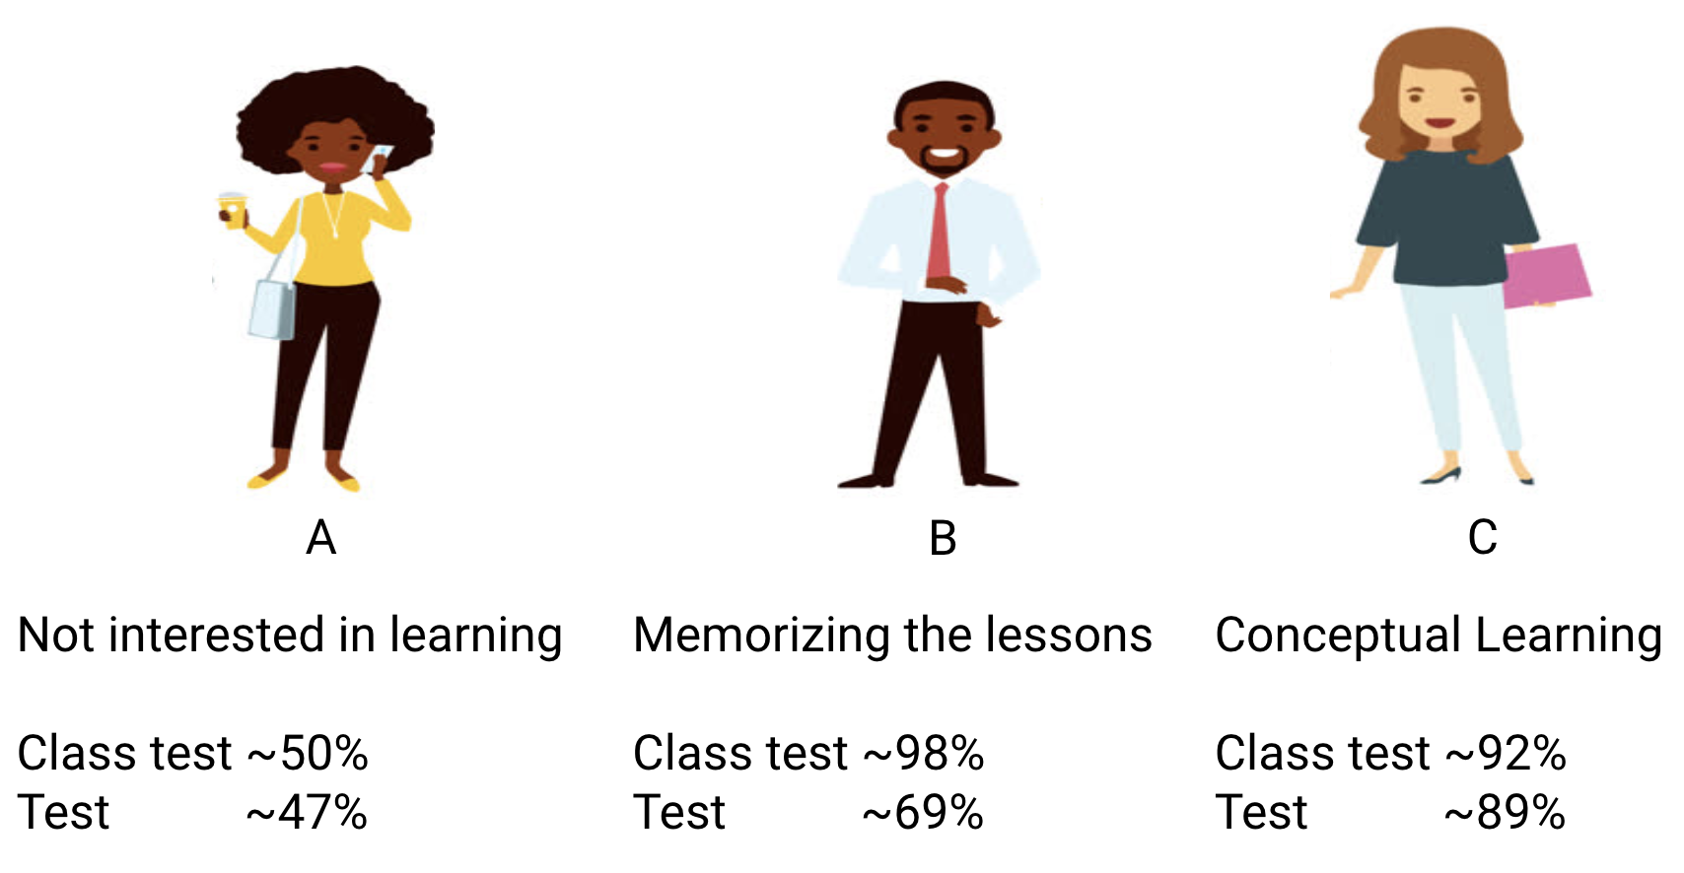

Slide 25
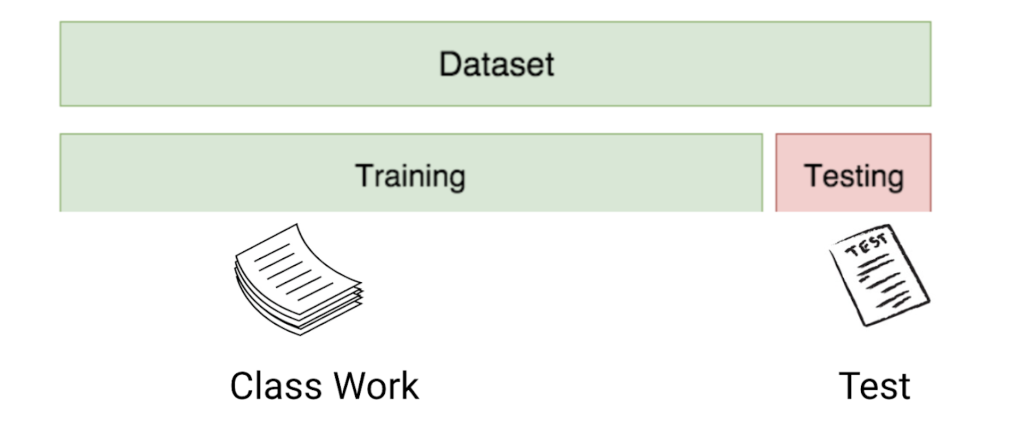
So, let’s work on connecting this example with the results of the decision tree classifier that I showed you earlier.

Slide 26
First, the classwork and class test resemble the training data and the prediction over
the training data itself respectively.
On the other hand, the semester test represents the test set from our data which we keep aside
before we train our model (or unseen data in a real-world machine learning project).
Now, recall our decision tree classifier I mentioned earlier. It gave a perfect score over the training set
but struggled with the test set. Comparing that to the student examples we just discussed, the classifier establishes an analogy with student B who tried to memorize each and every question in the training set.

Slide 27

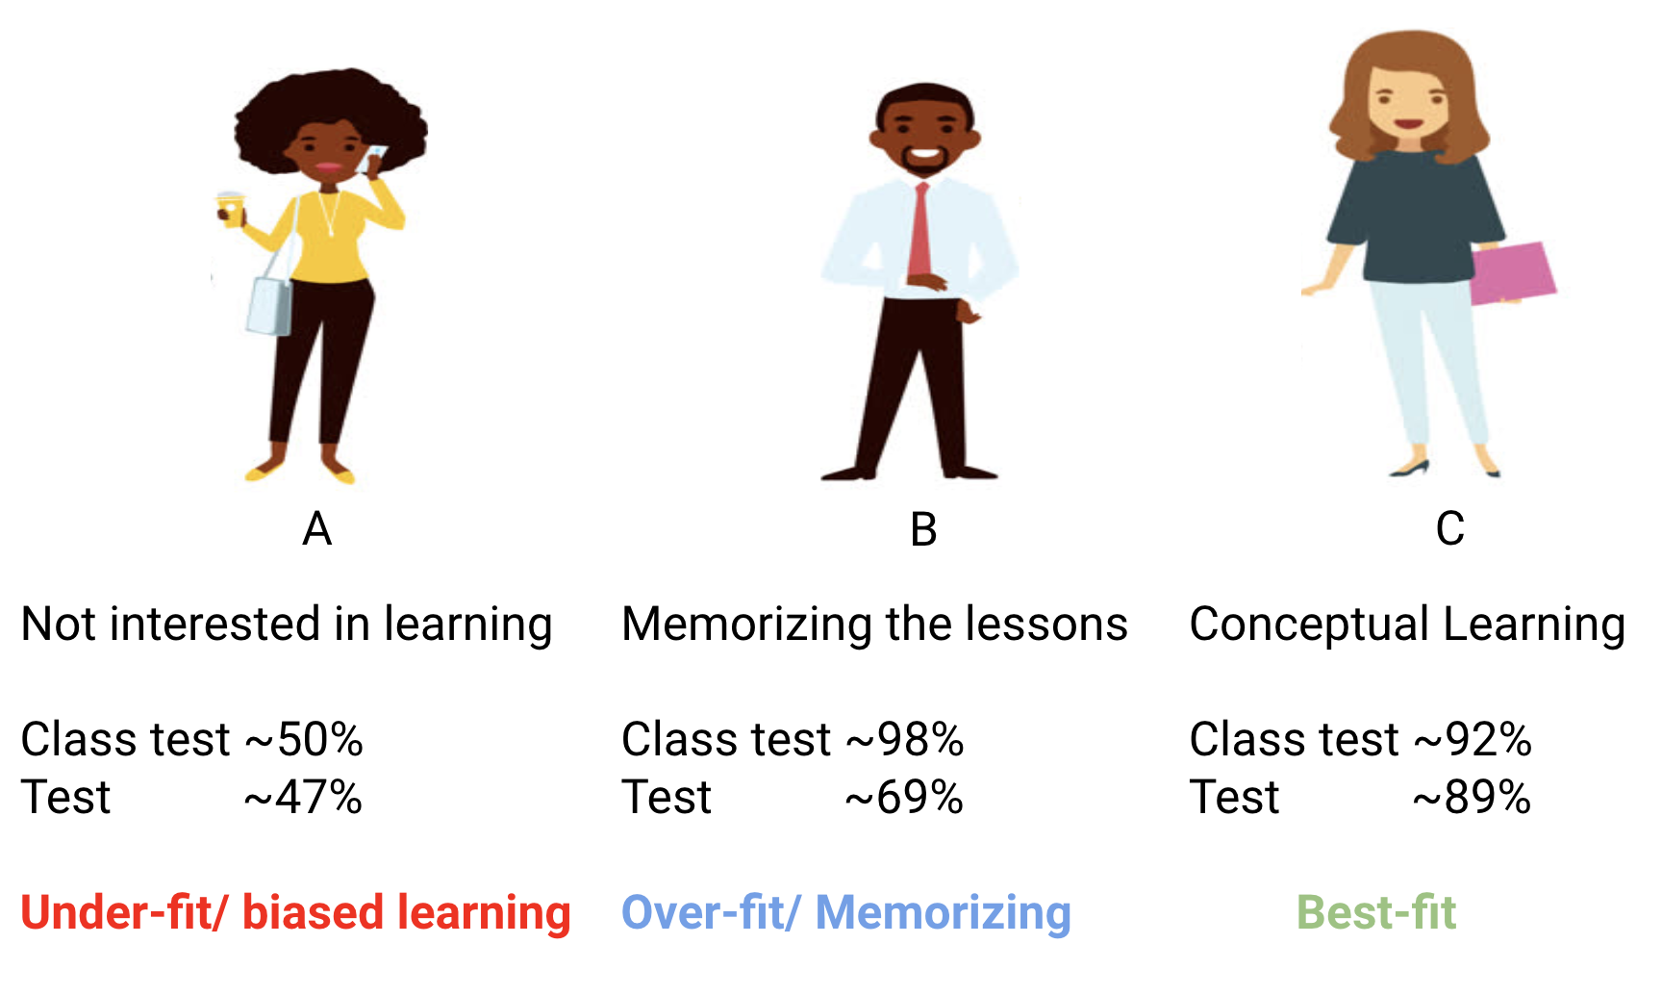
Similarly, our decision tree classifier tries to learn each and every point from the training data but suffers radically when it encounters a new data point in the test set. It is not able to generalize it well.

Slide 28
This situation where any given model is performing too well on the training data
but the performance drops significantly over the test set is called an overfitting model.
For example, non-parametric models like decision trees, KNN, and other tree-based algorithms are very prone to overfitting. These models can learn very complex relations which can result in overfitting. The graph below summarises this concept:

Slide 29
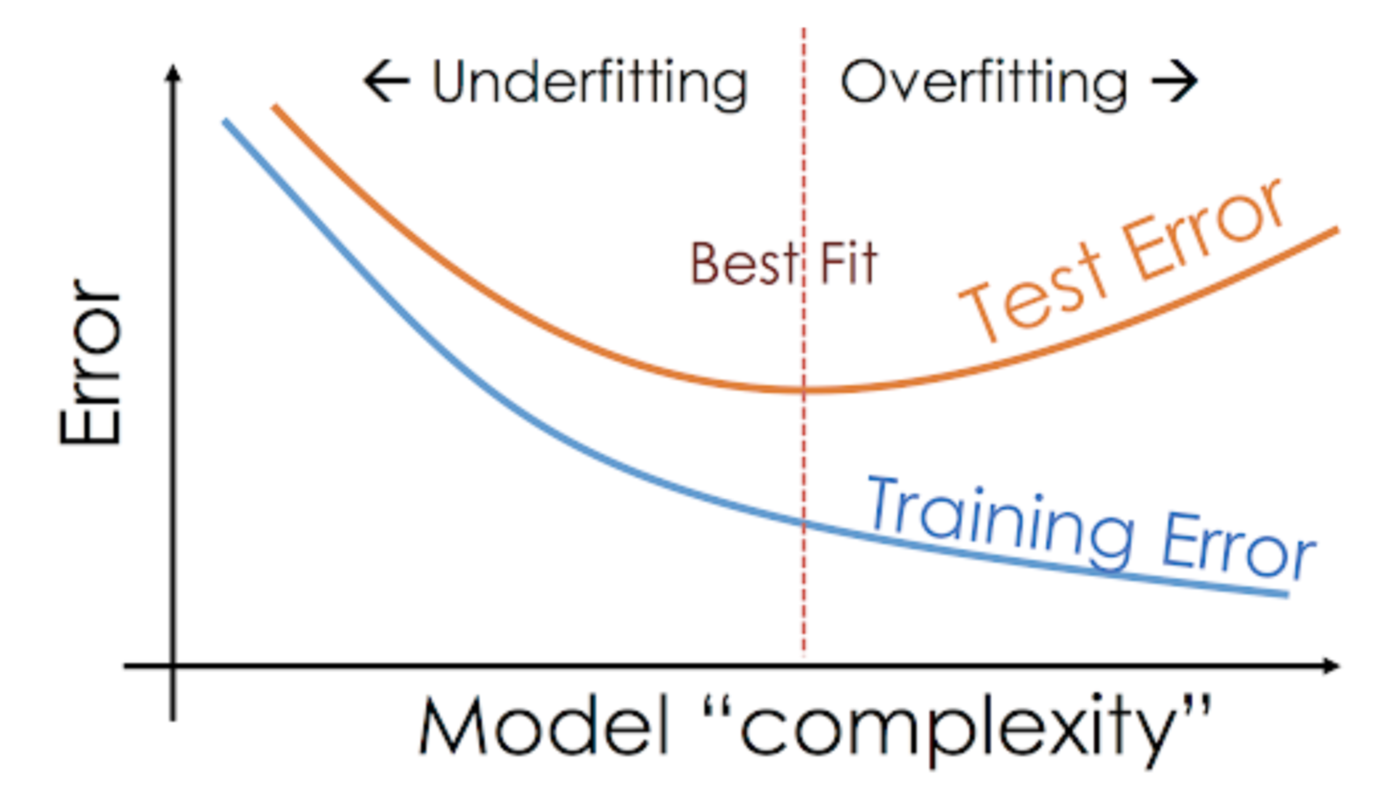

Slide 30
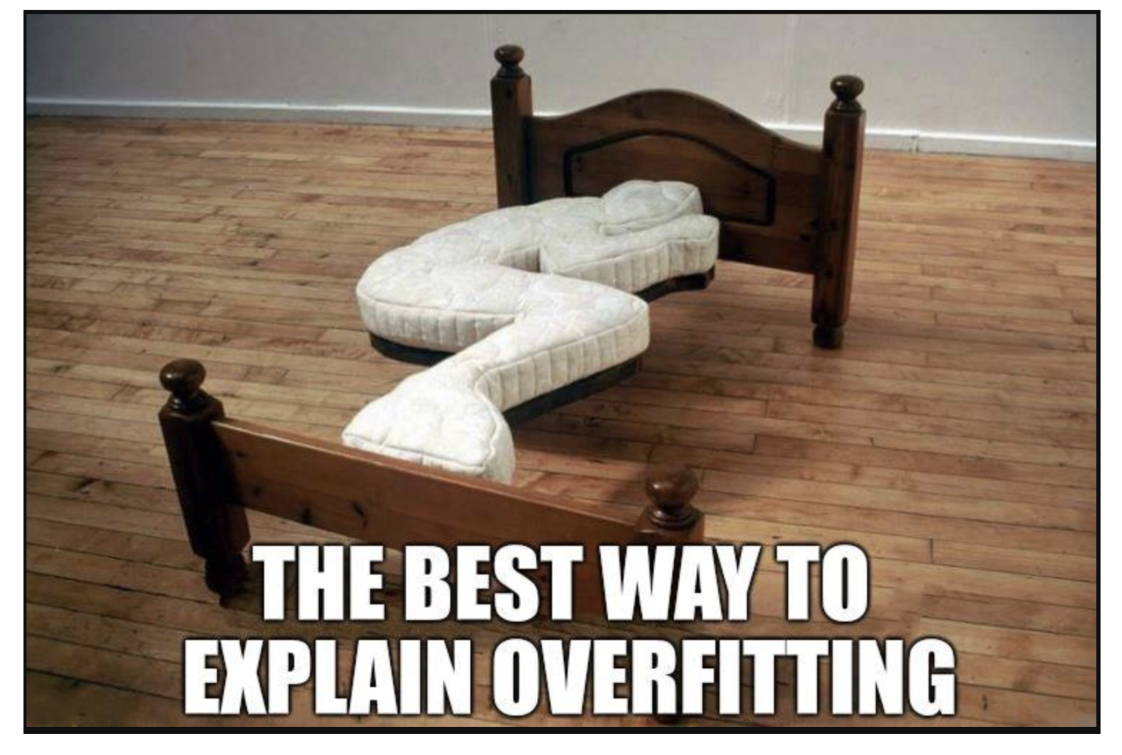
On the other hand, if the model is performing poorly over the test and the train set,
then we call that an underfitting model. An example of this situation would be building a linear regression model over non-linear data.

Slide 31
Thank you

